Slide 1
SDN and WN security
Saim Ghafoor
Lecture 4
The control plane:
Open Flow and controllers

Slide 2
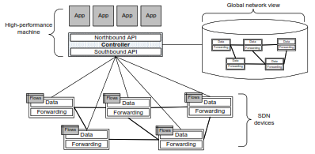
SDN operation

Slide 3
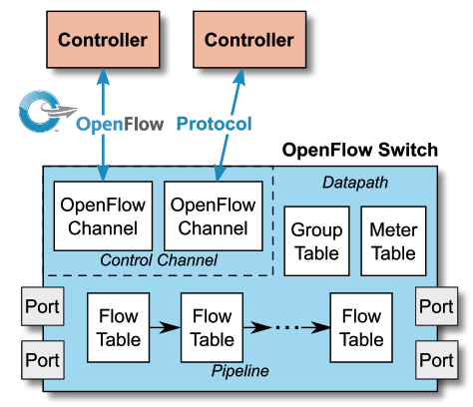
Switch components
An OpenFlow Logical Switch consists of
one or more flow tables and a group table, which perform packet lookups and forwarding, and
one or more OpenFlow channels to an external controller.
The switch communicates with the controller and the controller manages the switch via the OpenFlow switch protocol.
Using the OpenFlow switch protocol, the controller can add, update, and delete ﬂow entries in ﬂow tables, both reactively (in response to packets) and proactively.

Slide 4
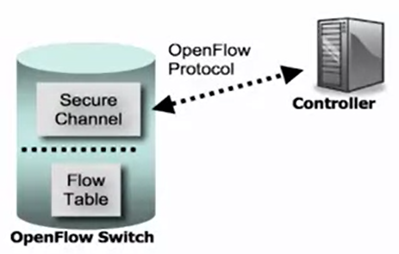
OpenFlow Protocol Specification
OpenFlow allows controller to talk to the OF switch using a secure channel
OF protocol instructs the OF switch to update its flow table entries to take different actions on various traffic flows that pass through the switch.
The purpose of the control channel is to update flow table and all the logic, how the flow table entries are updated.
OpenFlow controller communicates with switch over a secure channel
OpenFlow protocol defines message format
Purpose of control channel: update flow table
Logic is executed at controller
https://opennetworking.org/wp-content/uploads/2014/10/openflow-switch-v1.5.1.pdf

Slide 5
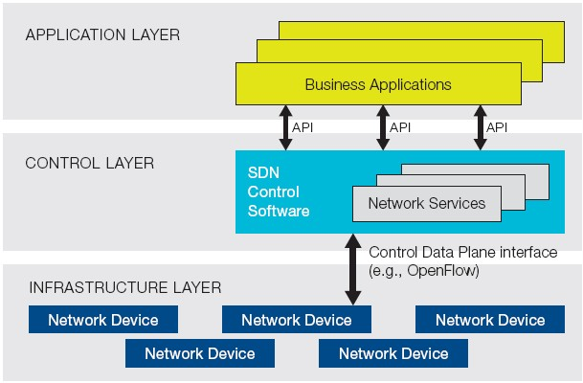
SDN vs. OpenFlow
ONF Definition
SDN performs Software Defined Forwarding
Controls data forwarding through the open API
SDN provides Management Abstraction
Can make more advanced applications
Currently implemented with OpenFlow
OpenFlow is misunderstood to be equivalent to SDN
No requirement for the use of OpenFlow within an SDN
OpenFlow is one of the SDN protocols, but most popular
Vendor independent control…
Simplify
Logical View of SDN architecture
Version | Date | Characteristics | Organization
OpenFlow 1.0 | 2009.12 | MAC, IPv4, single flow table | OpenFlow Consortium
OpenFlow 1.1 | 2011.2 | MPLS/tunnel, multiple flow tables, group table | OpenFlow Consortium
OpenFlow 1.2 | 2011.12 | IPv6, Config., extensible match support | ONF
OpenFlow 1.3 | 2012.9 | QoS (meter table)… | ONF
OpenFlow 1.4 | 2013.10 | Optical port monitoring and config (frequency, power) | ONF
OpenFlow 1.5 | 2014.12 | Egress table, pkt. type aware pipeline, flow entry stat trigger | ONF
Notes:
OpenFlow 1.5
Egress table: In previous versions of the specification, all processing was done in the context of the input port.
Version 1.5 introduces Egress Tables, enabling processing to be done in the context of the output port
(EXT-306). When a packet is output to a port, it will start processing at the first egress table where
flow entries can define processing and redirect the packet to other egress tables.
Packet Type Aware Pipeline: In previous versions of the specification, all packets must be Ethernet packets. Version 1.5 introduces a packet aware pipeline, enabling processing of other types of packets, such as IP packets or PPP packets (EXT-112). A new OXM pipeline field identifies the packet type. The packet type is defined in an extensible manner, it uses multiple namespaces defined by other standard and allow experimenter packet types.
Flow Entry Statistic Trigger: Polling flow entry statistics can induce high overhead and utilization for the switch. A new statistics trigger mechanism enable statistics to be automatically sent to the controller based on various statistics thresholds.

Slide 6
OpenFlow
Definition
A communication protocol that gives access to the forwarding plane of the network switch or router
Features
OpenFlow is similar to an x86 instruction set for the network
Separation of control plane and data plane
The data path of an OpenFlow switch consists of a Flow Table and an action associated with each flow entry
The control path consists of a controller which programs flow entry in the flow table
OpenFlow is based on an Ethernet switch, with an internal flow-table, and a standardized interface to add and remove flow entries
Components
OpenFlow controller
Process packet match, instruction & action set, pipeline processing
OpenFlow switch
Secure channel, flow table

Slide 7
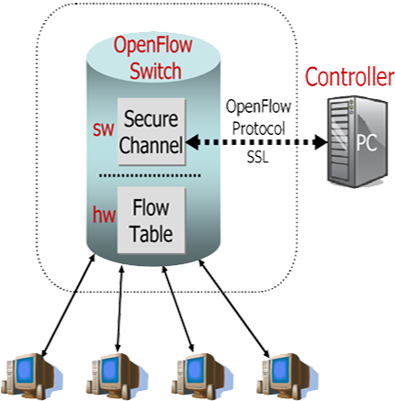

How Does OpenFlow Work?
OpenFlow Switch and Tables
App
App
App
General purpose PC, Server
Controller (Server Software)
OpenFlow
protocol
Ethernet Switch
Control Path
OpenFlow
Data Path, H/W

Slide 8




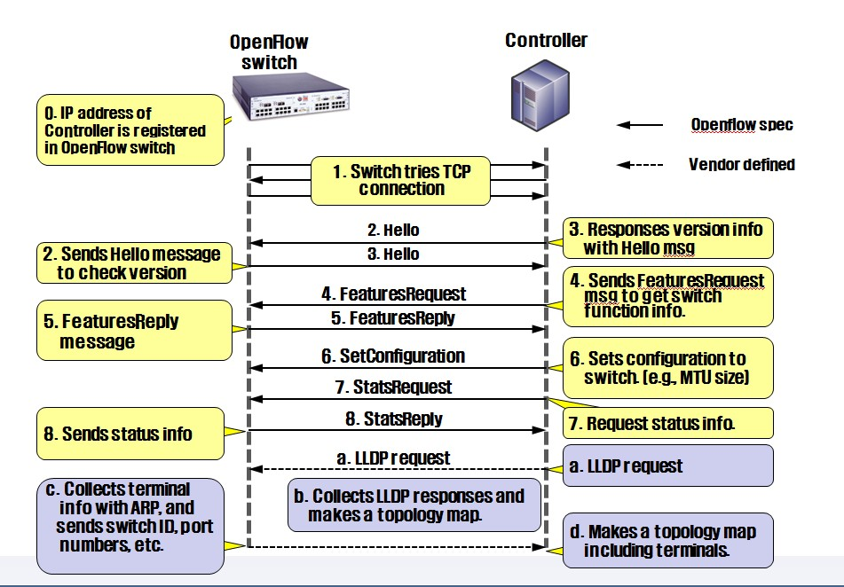


OpenFlow Communication
Connection Setup

Slide 9
Current Status of SDN Products and Solutions
Open Source
 | Solutions | OpenFlow version
Controller | NOX | Support OpenFlow 1.3 | C++ API
 | POX | Python version of NOX, Support OpenFlow 1.1 | Python API
 | Floodlight | Support OpenFlow 1.3 | BigSwitch joined OpenDaylight but left it on June 2013
 | Ryu | Support OpenFlow 1.4 | Python API
 | OpenDayLight (ODL) | Support OpenFlow 1.3 | 2014.2
Switch | Open vSwitch | Support OpenFlow 1.3
 | Ericsson soft switch | Support OpenFlow 1.3 | Compatible with Mininet Controller: NOX 1.3
Vendors
NEC: released OpenFlow 1.3 switch and controller… 2013.9
HP: released OpenFlow 1.3 data center switch … 2013
Centec Network, China: released Open SDN switch with OpenFlow1.3 support (implemented on OpenVswitch) … 2013.4
Brocade, OpenFlow 1.3 switch … 2014.6~

Slide 10
OpenFlow Protocol Format
Protocol Layer
OpenFlow control message relies on TCP protocol
Controllers listen on TCP port 6633/6653 to setup conn. with switch
6633/6653 became the official IANA port since 2013-07-18
OpenFlow message structure
Version
Indicates the version of OpenFlow which this message belongs
Type
Indicates what type of message is present and how to interpret the payload (version dependent)
Message length
Indicates where this message will be end, starting from the first byte of header
Transaction ID (xid)
A unique value used to match requests to response
Bit Offset | 0 ~ 7 | 8 ~ 15 | 16 ~ 23 | 24 ~ 31
0 ~ 31 | Version | Type | Message Length
32 ~ 63 | Transaction ID
64 ~ ? | Payload
OpenFlow Message Structure

Slide 11
Flow tables
Flow tables allow the device to evaluate incoming packets and take the appropriate action based on the contents of the packet.
Depending on that evaluation, actions are taken. These actions may include forwarding the packet to a speciﬁc port, dropping the packet, and ﬂooding the packet on all ports, among others.
Flow tables consist of a number of prioritised flow entries, each of which typically consists of two components, match ﬁelds and actions.

Slide 12
Flow Tables and ﬂow entries
match ﬁelds: to match against packets. These consist of the ingress port and packet headers, and optionally other pipeline ﬁelds such as metadata speciﬁed by a previous table.
priority: matching the precedence of the ﬂow entry.
counters: updated when packets are matched.
instructions: to modify the action set or pipeline processing.
timeouts: maximum amount of time or idle time before ﬂow is expired by the switch.
cookie: opaque data value chosen by the controller. May be used by the controller to ﬁlter ﬂow entries aﬀected by ﬂow statistics, ﬂow modiﬁcation and ﬂow deletion requests. Not used when processing packets.
ﬂags: ﬂags alter the way ﬂow entries are managed, for example, the ﬂag OFPFF_SEND_FLOW_REM triggers ﬂow removed messages for that ﬂow entry.

Slide 13

OpenFlow: Flow Table
Counters used when controller calculates paths
Flow Table
Flow entry
match field
counter
Action
(Instruction)
priority
Timeout
cookie
1
n
…
…
…
Actions(Instructions)
Forward packet to port(s)
Encapsulate and forward to controller
Drop packet
Send to normal processing pipeline
Modify Fields
Etc.
Flow table
Match field= L1~L4 header information
OpenFlow 1.0 → 12 tuples
OpenFlow 1.1 → 15 tuples
OpenFlow 1.3 → 40 tuples (158 bytes)
L1
L2
L3
L4
Switch
Port
MAC src
MAC
dst
Ether type
VLAN ID
VLAN Priority
MPLS Label
MPLS traffic class
Src
IP
Dst
IP
Protocol No.
Src
TCP/UDP port
Dst
TCP/UDP port
Meta data
ToS
Match fields of OpenFlow 1.1

Slide 14
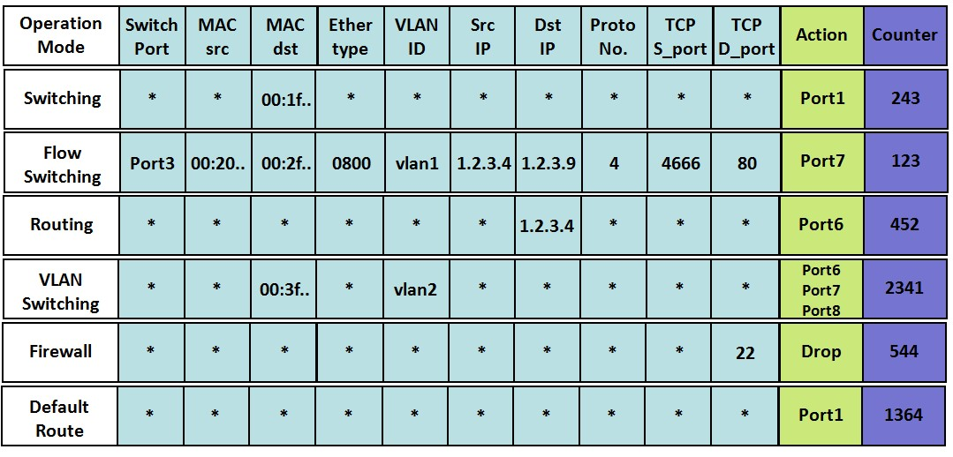
OpenFlow: Flow Table
Flow Table
Wild card (*) means “does not matter” – not important field

Slide 15
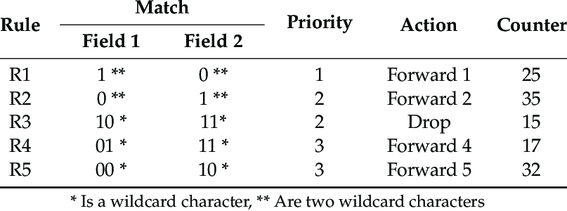

Slide 16
Protocol specifications defines
Flow table: Performs packet lookup
All packets compared to flow table for match
Actions depend on match being found
If no match, traffic is sent to controller
Secure channel: Communication to external controller

Slide 17
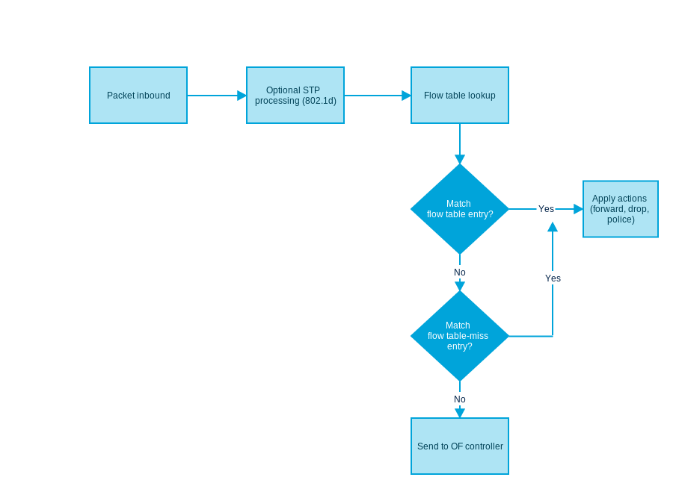
Matching in openFlow
It is better to match tables at the switch to avoid traffic being forwarded to the controller (scalability)

Slide 18
OpenFlow Pipelining
Pipelining
The flow tables of a switch are sequentially numbered, starting at 0
A packet is processed sequentially in multiple flow tables (version 1.1)
If a flow entry is found, the instruction set included in that flow entry is executed
Instructions may explicitly direct the packet to another flow table (“goto-table”)
Pipeline processing can only go forward and not backward
Two stage pipeline processing (version 1.5)
Ingress processing
Mandatory, performed before egress processing, use the rules specified in ingress tables
Egress processing
Optional, performed in the context of output port, use the rules specified in egress tables
Egress table can be configured during feature request/reply phase
Useful to manage complicated processing
E.g., table 1 for VLAN processing, table 2 for multicast group processing
Ingress processing
Egress processing
Flow Table 0
Flow Table n
Flow Table e
Flow Table e+m
Packet In
…
Group Table
…
Packet Out
Instruction/Action
Instruction/Action
Instruction/Action
Instruction/Action

Slide 19
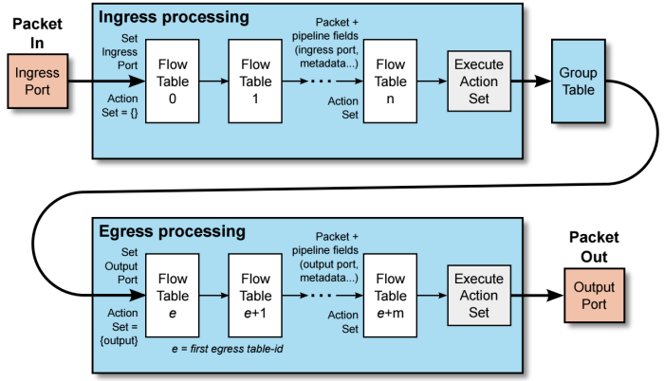

Slide 20
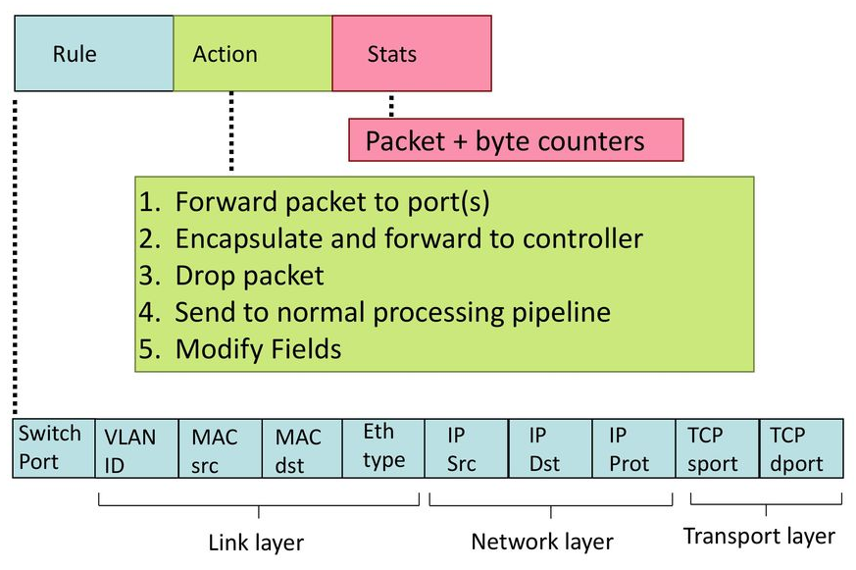
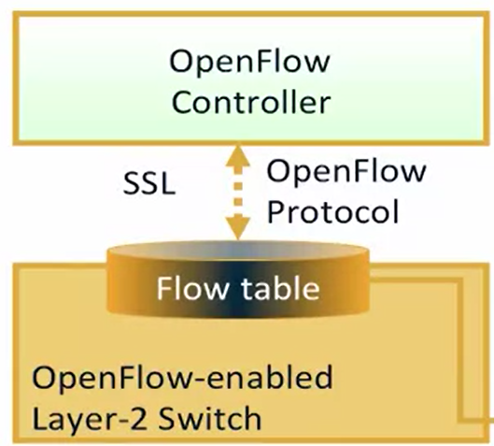

Slide 21
Once a switch identifies a matching flow table entry it will perform the action that is specified in flow table entry.
Actions: Forward/Drop
Forward
ALL: Send out all interfaces, not including the incoming interface
CONTROLLER: Encapsulate and send to the controller
LOCAL: Send to the switch local networking stack
TABLE: Perform actions in flow table. Only for packet out messages
IN-PORT Send the packet out the input port
Optional: Normal forwarding, spanning tree
Drop: A flow-entry with no specified action indicates that all matching packets should be dropped.

Slide 22
Optional Actions: Modify/Enqueue
Modify: Option to modify packet header values in the packet (eg VLAN ID)
Set VLAN ID, priority etc
Set destination IP address
Enqueue: Send the packet through a queue attached to a port
QoS or traffic shaping

Slide 23
OpenFlow ports
OpenFlow ports are the network interfaces for passing packets between OpenFlow processing and the rest of the network.
Logically connected to each other and packets can be forwarded from one OF switch to another.
An OpenFlow switch makes a number of OpenFlow ports available for OpenFlow processing.
OpenFlow packets are received on an ingress port and processed by the OpenFlow pipeline which may forward them to an output port.
The standard are defined as physical port, logical ports and reserved ports.

Slide 24
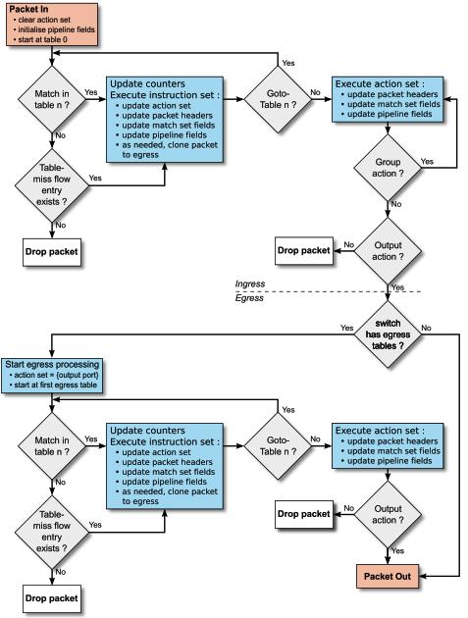
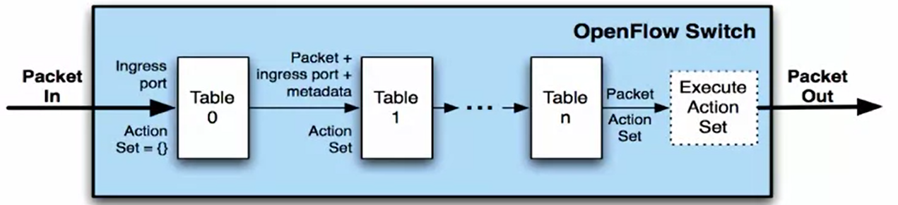
OpenFLow (v1.4 v1.5) Enhancement
Action Set: Set of actions to be performed on each packet
Group: A list of action sets
Each table updates fields, modifies action set

Slide 25
OpenFlow Messages
OpenFlow Protocol supports 3 message types, each with their own setup of sub-types:
Controller-to-switch
Asynchronous
Symmetric

Slide 26
Controller-to-switch Messages
Controller-to-switch Messages are initiated by the controller and used to directly manage or inspect the switch. These messages include:
Features – switch needs to request identity
Configuration – set and query configuration parameters
Modify-State – also called ‘flow mod’, used to add, delete and modify flow/group entries
Read-States – get statistics
Packet Outs – controller sends a message to the switch, either a full packet or buffer ID.
Barrier – Request or reply messages are used by the controller to ensure message dependencies have been met and receive notification.
Role-Request – set the role of its OpenFlow channel
Asynchronous-Configuration – set an additional filter on the asynchronous message that it wants to receive on the OpenFlow Channel

Slide 27
Asynchronous Messages
Asynchronous messages are initiated by the switch and used to update the controller of network events and changes to the switch state. These messages include:
Packet-in – transfer the control of a packet to the controller
Flow-Removed – inform the controller that flow has been removed
Port Status – inform the controller that the switch has gone down
Error – notify controller of problems

Slide 28
Symmetric Messages
Symmetric messages are initiated either by the switch or controller and sent without solicitation. These messages include:
Hello – introduction or keep-alive messages exchanged between switch and controller
Echo – sent from either switch or controller, these verify the liveness of the connection and are used to measure latency or bandwidth
Experimenter – a standard way for OpenFlow switches to offer additional functionality within the OpenFlow message type space.

Slide 29
OpenFlow Protocol Messages
C: OpenFlow Controller
S: OpenFlow Switch
AM: Asynchronous message CSM: Control/Switch Message SM: Symmetric Message
Category | Message | Type | Description
Meta Info. Configuration | Hello (SM) | C → S | following a TCP handshake, the controller sends its version number to the switch.
 | Hello (SM) | S → C | the switch replies with its supported version number.
 | Features Request (CSM) | C → S | the controller asks to see which ports are available.
 | Set Config (CSM) | C → S | in this case, the controller asks the switch to send flow expirations.
 | Features Reply (CSM) | S → C | the switch replies with a list of ports, port speeds, and supported tables and actions.
 | Port Status | S → C | enables the switch to inform that controller of changes to port speeds or connectivity..
Flow Processing | Packet-In (AM) | S → C | a packet was received and it didn't match any entry in the switch's flow table, causing the packet to be sent to the controller.
 | Packet-Out (CSM) | C → S | Instructs a switch to send a packet out to one or more switch ports.
 | Flow-Mod (CSM) | C → S | instructs a switch to add a particular flow to its flow table.
 | Flow-Expired (CSM) | S → C | a flow timed out after a period of inactivity.

Slide 30

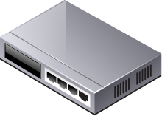
Packet Forwarding in OpenFlow
Packet Forwarding
Reactive flow insertion
A non-matched packet reaches to OpenFlow switch, it is sent to the controller, based on the info in packet header, an appropriate flow will be inserted
Always need to query the path from controller during packet arrival → slow
Can reflect the current traffic status
Proactive flow insertion
Flow can be inserted proactively by the controller to switches before packet arrives
No need to communicate during packet arrival → fast packet forwarding
Cannot reflect the current traffic status
SRC | DST | ACT | …
OpenFlow Controller
SRC | DST | ACT | …
h1 | h2 | p2
h1 h2 p2
acquire route
insert flow
1
2
1
2
host1
switch1 (reactive)
switch2 (proactive)
host2

Slide 31

Topology Discovery in OpenFlow
Purpose
To construct an entire network view
Method
Use the Link Layer Discovery Protocol (LLDP)
IDX | SRC | DST | SRC PORT | DST PORT
153 | sw. A | sw. B | p2 | p1
… | … | … | … | …
357 | sw. B | sw. A | P1 | p2
OpenFlow Controller
PACKET_OUT with LLDP
PACKET_OUT with LLDP
p1
PACKET_IN with LLDP
p2
p2
LLDP
p1
Notes:
OpenFlow Switch 포트의 status 정보를 스위치에서 Controller에 보내면서 Topology Discovery가 이루어진다.
스위치의 포트가 Down에서 Up으로 변경된다.
이 포트의 변경 사항을 Switch에서 Controller에 보낸다.
Controller는 LLDP가 Switch의 변경된 포트를 통해 전송되도록 Packet Out Message로 생성하여 전송한다.
이것을 수신한 Switch는 Packet Out Message에 담긴 LLDP를 인접한 Switch에 전달한다.
LLDP를 받은 인접한 Switch는 해당 LLDP를 어떻게 처리해야 할지를 모르기 때문에 이 Packet을 Controller에 Packet In Message 형태로 보낸다.
Controller는 이를 통해 스위치 간 연결 정보를 확인한다.

Slide 32
OpenFlow Group Table
Group Table & Types (version 1.1)
All: multicast
Select: load sharing
Indirect: simple indirection
Fast-failover: rerouting
Group Table
Action
Bucket
Table 0
Table 1
……
Table n
Instruction/Action
Instruction/Action
Instruction/Action
Group table
Group ID
Group type
Counter
Action buckets
Multicast
Load sharing
100
all
Port1 : output
Port3 : output
Port5 : output
………
Match field
Counter
Action
Flow table
Dst IP= 224.2.3.9
Group 100
Indirection
Rerouting

Slide 33
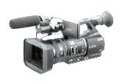

OpenFlow Group Table
Multicast
Type=all
Group Table
Group ID | Group Type | Counter | Action Buckets
100 | All | 999 | Port2, Port3, Port4
Flow Table
Switch Port | MAC src | MAC dst | Ether Type | VLAN ID | Src IP | Dst IP | Proto No. | TCP S Port | TCP D Port | Action
* | * | 00:FF:.. | * | * | * | * | * | * | * | Port 6
Port 1 | * | * | 0800 | * | 224… | 224… | 4 | 4566 | 6633 | Group 100
1
2
3
4

Slide 34
OpenFlow Group Table
Group Table
Load Balancing
Type=select
Group ID | Group Type | Counter | Action Buckets
100 | Select | 999 | Port2, Port3
Flow Table
Switch Port | MAC src | MAC dst | Ether Type | VLAN ID | Src IP | Dst IP | Proto No. | TCP S Port | TCP D Port | Action
* | * | 00:FF:.. | * | * | * | * | * | * | * | Port 1
Port 1 | * | * | 0800 | * | 1.2.3… | * | 4 | * | 80 | Group 100
1
2
3

Slide 35
OpenFlow Group Table
Indirection
Type=indirect
Group Table
Group ID | Group Type | Counter | Action Buckets
100 | Indirect | 777 | Port 5
Flow Table
Switch Port | MAC src | MAC dst | Ether Type | VLAN ID | Src IP | Dst IP | Proto No. | TCP S Port | TCP D Port | Action
* | 00:FF… | * | 0800 | * | 1.2.2… | 11.1… | * | * | * | Group 100
* | 00:FF... | * | 0800 | * | 1.2.3… | 11.1… | * | * | * | Group 100
1
4
2
3
5

Slide 36
OpenFlow Group Table
Group Table
Fast Failover
Type=fast-failover (ff)
Group ID | Group Type | Counter | Action Buckets
100 | Fast-failover | 777 | Port4, Port5, Port6
Flow Table
Switch Port | MAC src | MAC dst | Ether Type | VLAN ID | Src IP | Dst IP | Proto No. | TCP S Port | TCP D Port | Action
Port 1 | * | * | * | * | 1.2.2 | * | * | * | * | Port 7
Port 1 | 00:FF… | * | 0800 | * | 1.2.3… | 11.1… | * | * | * | Group 100
1
4
2
3
5
6

Slide 37
OpenFlow Meter Table
Meter Table (ver 1.3)
Counts packet rate of a matched flow
QoS control → Rate-limit, DiffServ …
Meter Table
Meter ID | Band Type | Rate | Counter | Argument
100 | Drop (remark DSCP) | 1000 kbps | 1000 | xxx
Flow Table
Switch Port | MAC src | MAC dst | Ether Type | Src IP | Dst IP | Proto No. | TCP S Port | TCP D Port | Inst. Meter | Action
Port 1 | * | * | * | 1.2.2 | * | * | * | * | N/A | Port 7
Port 1 | 00:FF… | * | 0800 | 1.2.3… | 11.1… | * | * | * | Meter 100 | Port 2

Slide 38
Advantages of using OpenFlow
There are several advantages of OpenFlow and SDN rather than traditional networks:
SDN enables the separation of control and data plane, which means switches can use all their hardware resources in just forwarding data instead of computing routes.
OpenFlow provides an easy way of communication between the controller and switch, easily implemented in an existing network.
Most current devices support OpenFlow; it is not enabled by default, but we can easily enable and use it to transition to SDN.
It provides security with a TLS connection to prevent snooping and DoS attacks on the controller and/or the network.
OpenFlow does NOT change the configuration for a switch. It just updates the flow tables, which define the path for a packet.

Slide 39
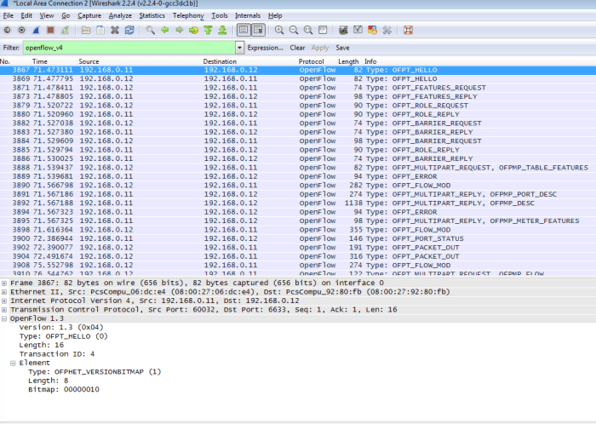

Slide 40
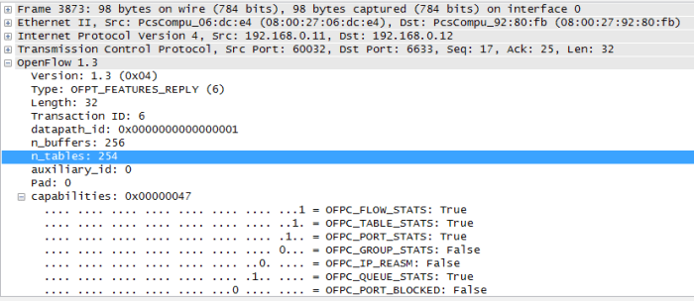

Slide 41
Who controls OpenFlow?
Open Network Foundation (ONF), which is a non-profit consortium. Dedicated to “the transformation of networks through SDN”
Which companies make up ONF?
Deutsche Telekom, Facebook, Yahoo, Google, Microsoft, NTT Communications, Verizon, HP, Huawei, IBM, Infinera, Korea Telecom, Cisco, ZTE Corp, and many more

